Slide 1

An Analysis of a new strategy for incorporating Opening Book in Monte-Carlo Tree Search with application to Chess
Evaluating techniques to leverage opening books in Monte Carlo Tree Search for chess

Slide 2
“"The opening is the most difficult stage of the game of chess."”
- ANATOLY KARPOV

Slide 3
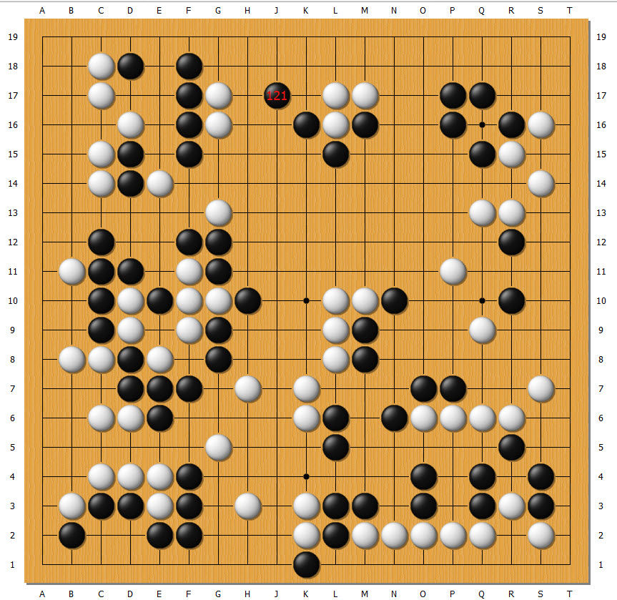
Overview of MCTS
Monte Carlo Tree Search is a simulation-based algorithm that has achieved major success in games like Go and Hex. It is well-suited for domains with large state space.

Slide 4
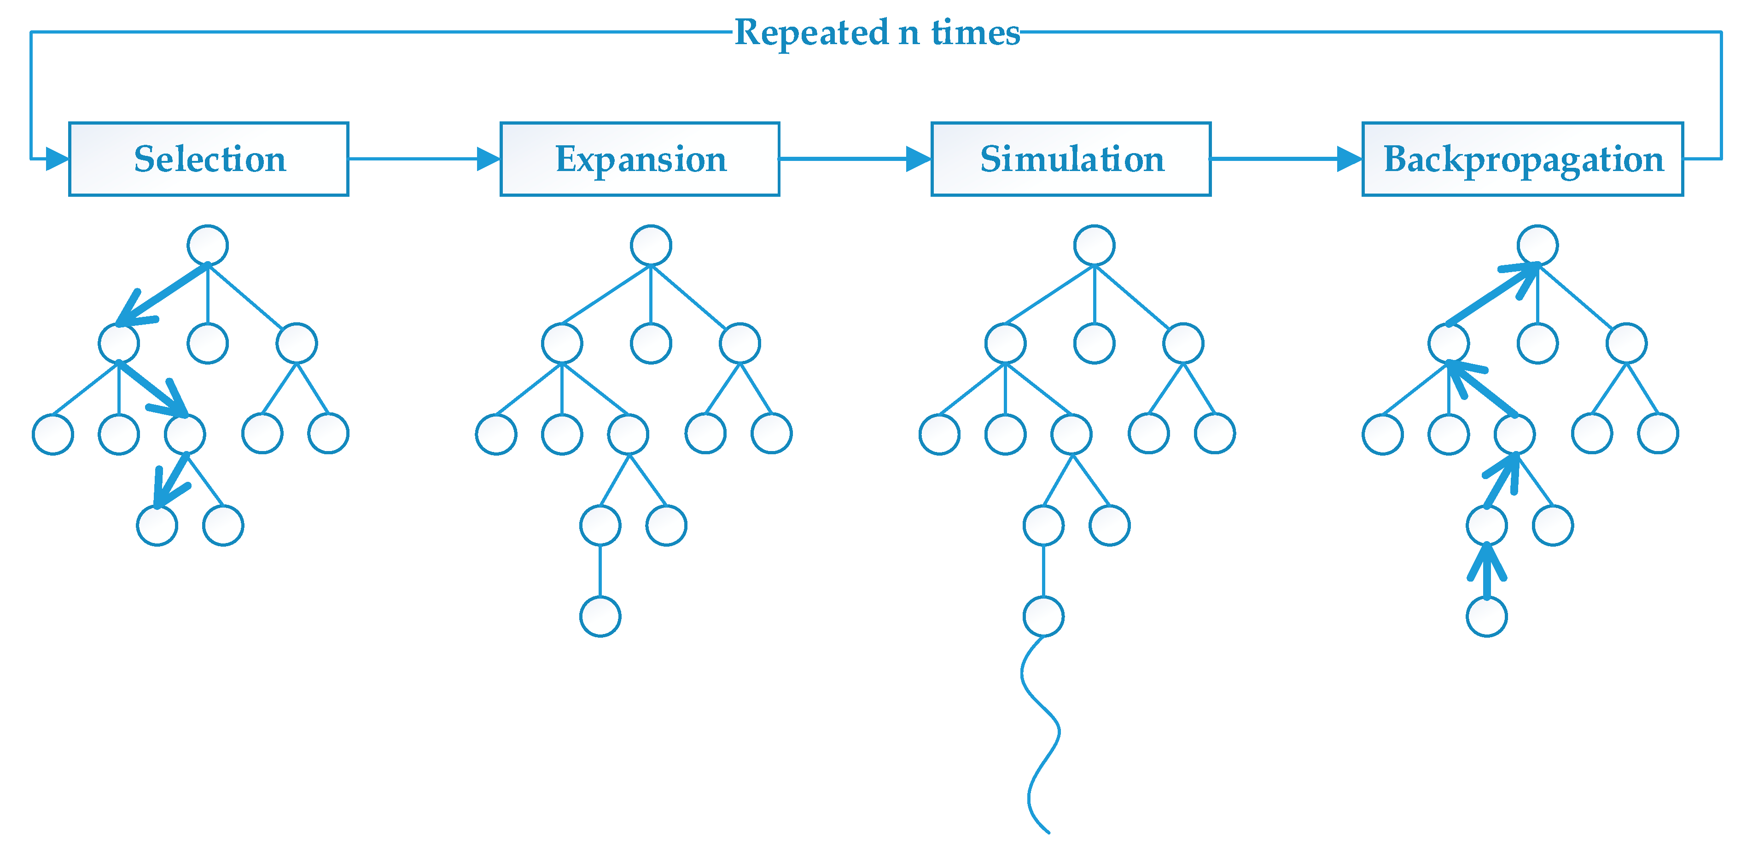
4 Phases of Monte Carlo Tree Search

Slide 5
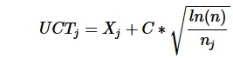
Upper Confidence Bound Applied on Trees(UCT)
X_{j} is the average score of the child
n is the number of times the parent has been visited
n_{j} is the number of times the child has been visited
C is a constant to adjust the amount of exploration

Slide 6

Stockfish NNUE
The Stockfish chess engine uses a neural network called NNUE (Efficiently Updateable Neural Network) to evaluate chess positions. The NNUE can quickly update evaluations as the position changes, without re-evaluating the entire position each time.

Slide 7
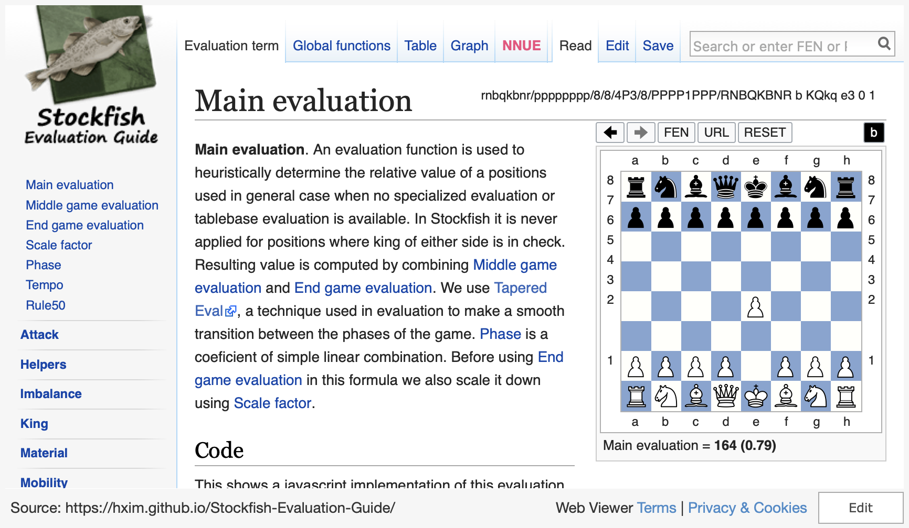
Demo Of Heuristic Function
Notes:
https://hxim.github.io/Stockfish-Evaluation-Guide/

Slide 8


Problem with Monte Carlo Tree Search in Opening Phase
High branching factor
Lack of domain knowledge
MCTS has high branching factor in opening phase leading to shallow search
MCTS lacks chess domain knowledge about good openings
Using opening books can constrain search and provide domain knowledge to address problems of MCTS in opening phase

Slide 9


Aim
Investigate opening books with MCTS for chess
Improve MCTS opening performance
Aim to find effective methods to leverage opening books
Seek to improve the performance of MCTS algorithms during the opening phase of chess games
The research aims to improve MCTS chess performance by effectively integrating opening books, despite inherent challenges.

Slide 10


Strategies to Leverage Opening Books
Direct Move
Increasing Exploration Constant
Play the moves found in the opening book directly before getting into selection phase
Increasing exploration constant for the moves found in opening book in selection phase
These two strategies were used in the experiment

Slide 11
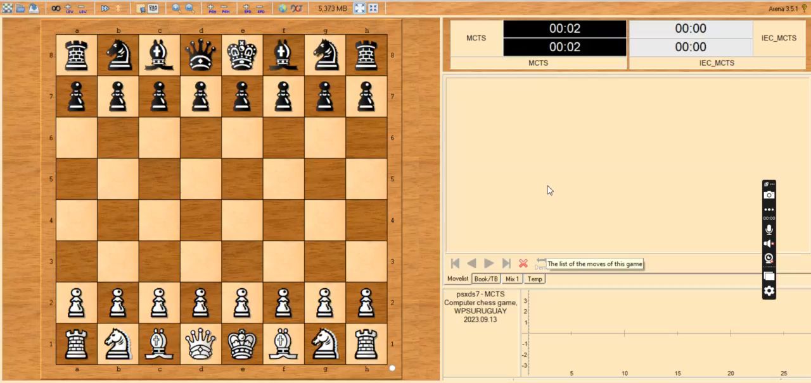

Slide 12
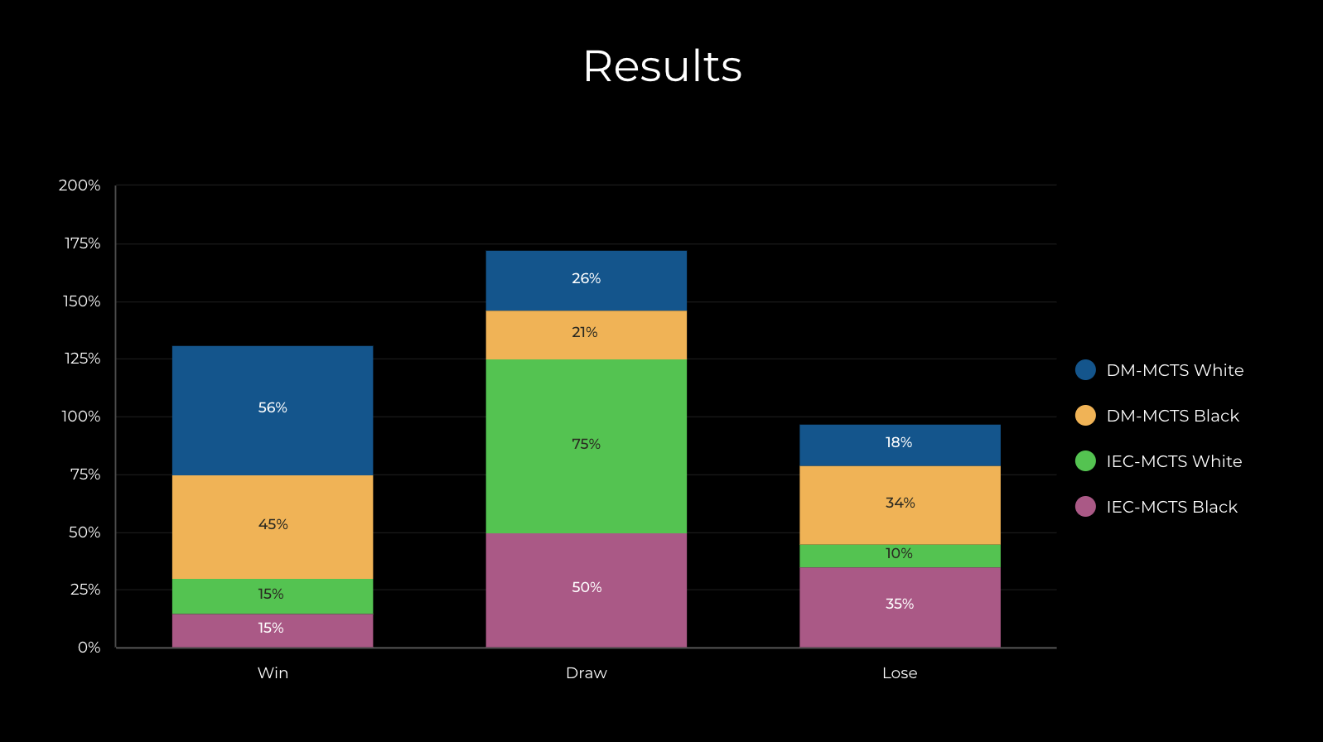

Slide 13


Why IEC-MCTS did not perform well?
Computational cost
Balance of exploration and exploitation
IEC-MCTS has higher computational cost in selection phase compared to DM-MCTS
IEC-MCTS may not balance exploration and exploitation well
IEC-MCTS did not perform as well as DM-MCTS likely due to issues with computational cost, balancing exploration/exploitation, and ineffective use of increased exploration constant.

Slide 14


Future Applications
Vehicle Routing
Retrosynthesis
Game AI
MCTS can optimize vehicle routes by leveraging opening databases
MCTS and opening databases enable efficient retrosynthetic analysis
Opening books improve MCTS performance in games like chess
Opening databases enhance MCTS across diverse applications like vehicle routing, retrosynthesis, and game AI.

Slide 15
Thank you
Please let me know if you have any other questions!

